Slide 1
HINT VERSIONS
STUDENT PRACTICE

Slide 2
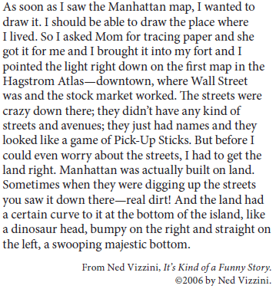
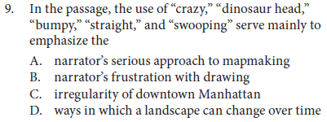
9.

Slide 3
9.
HINT: Think about the meaning of these certain words and their connotations. Also think about the differences in the words, “bumpy” and “straight”, showing change in the map.

Slide 4
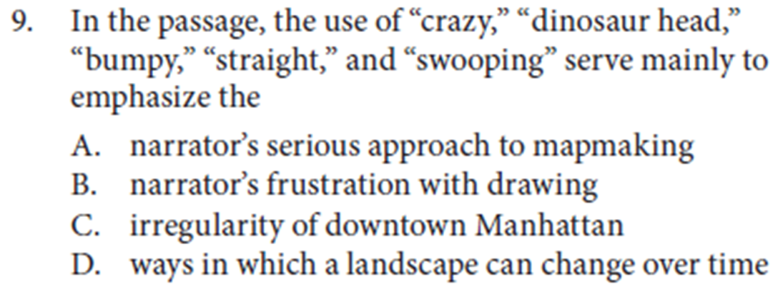
Answer
9.
There is no indication from these words that the narrator is serious
There is no indication from these words that the narrator is frustrated
YES! The differences in words describe the abnormality
There is no indication from these words that Manhattan’s landscape has changed over time

Slide 5
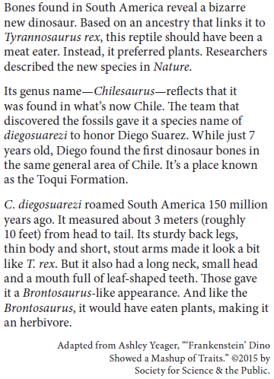
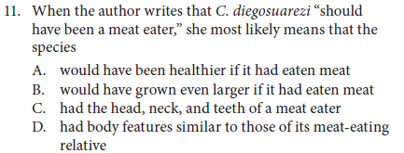
11.

Slide 6
11.
HINT: The entire sentence the quote was in about its T-rex relative

Slide 7
Explanation
11.
Answer A: Would have been healthier if it had been a meat eater, is wrong since health of the dinosaur has nothing to do with the passage. It’s that the new Dinosaur is a relative of the t-rex
Answer B: Would have been larger is it had been a meat eater, is wrong since the size of the dinosaur isn’t relevant to the diegosaurezi being a relative of the T-rex
Answer C: Had the head, neck, and teeth of a meat eater, is wrong because those are the diegosaurezi’s herbivore traits
Answer D: It has similar traits to its meat-eating relative, is correct because it discusses the biological relationship to the t-rex
Correct answer is D

Slide 8
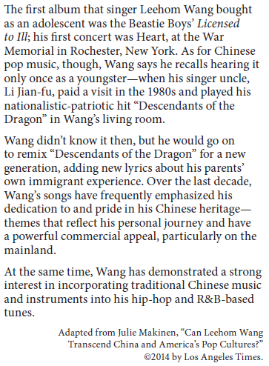
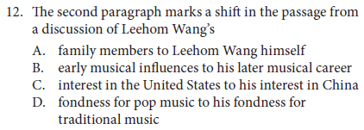
12.

Slide 9
12.

Slide 10
12.
No, its not spoken from a family member perspective
No, it never talks about his interest in America
No, he never talks about his interest in pop music
B is the correct answer because in the first paragraph he talks about his childhood and the musical influences that he had. Then in the second paragraph he talks about how he went on to making his own music based off of his uncles song that he heard as a child.

Slide 11
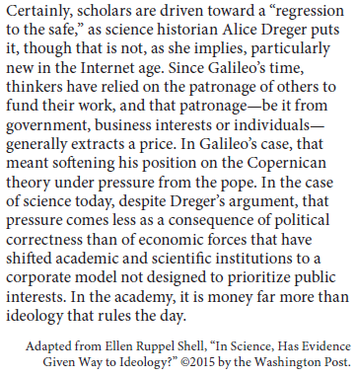
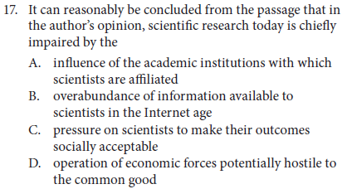
17.

Slide 12
17.

Slide 13
17.
Incorrect because they aren’t impairing scientific research.
Incorrect because the more resources available makes scientific research better rather than impairing it.
Incorrect because the passage says that money is more necessary than ideology. Also, the political correctness is less important than the economic forces that drive the research.
Correct because the economic conditions are more important than the political conditions. The research is not designed to prioritize public interest.

